Slide 1
Telesurgery Cybersecurity Prediction
Submitted by
Shibin t s

Slide 2
INTRODUCTION
Telesurgery relies on real-time data transmission, making it highly sensitive to network latency, data breaches, and system manipulation.
Cyber threats such as hacking, malware, and unauthorized access can disrupt surgical procedures and compromise patient data.
Strong cybersecurity measures including encryption, authentication, and continuous monitoring are essential for safe telesurgical operations. Addressing cybersecurity risks builds trust among patients, surgeons, and healthcare institutions and supports the future growth of remote surgery

Slide 3
Objective
To understand the importance of cybersecurity in telesurgery and why it is
critical for patient safely
To identity common cyber threats and risks associated with remote surgical
To highlight simple and effective security measures to protect telesurgery systems.
To emphasize the need for secure and reliable technology in the future of remote healthcare

Slide 4
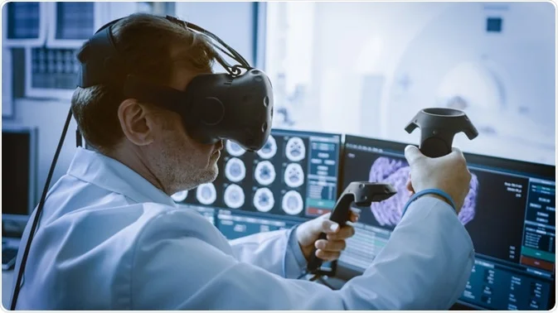
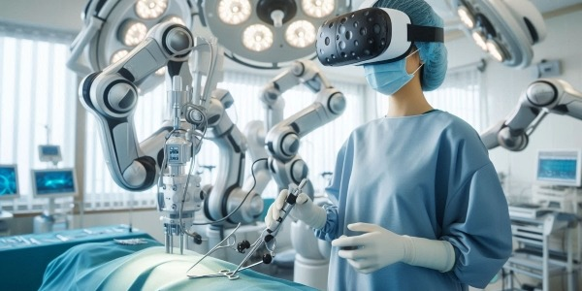
CYBERSECURITY IN TELESURGERY
Cybersecurity in telesurgery is the protection of remote surgical systems, networks, and patient data from cyberattacks during online surgical procedures. It ensures safe communication between the surgeon and the robotic system
Importance:
Prevents hacking and system manipulation
Protects patient data and surgical accuracy
Ensures uninterrupted remote surgery
Basic Security:
Secure Network + Encryption + Authentication

Slide 5
Key Concepts
Real-time communication must be secure and have low latency to avoid delays during surgery.
Strong authentication ensures only authorized surgeons and systems can access surgical controls.
Data encryption protects live video, control commands, and patient information from interception.
Continuous system monitoring helps detect and respond to cyber threats immediately.
System reliability and backup mechanisms are essential to maintain safe operation during failures or attacks.

Slide 6
Data Collection
Purpose: The goal of this project is to analyze and predict cybersecurity risks in telesurgery to ensure safe and reliable remote surgical procedures.
Front End (Gradio): A simple Gradio interface is used to collect inputs such as network latency, system access details, encryption status, and threat alerts for security monitoring.
ML Models Used: Random Forest, SVC and XG-Boost are applied to detect cyber threats and system anomalies.

Slide 7
Process of Dataset
Data Acquisition: Collected telesurgery-related data such as network latency, access logs, encryption status, and threat events.
Data Cleaning: Removed missing values, duplicates, and irrelevant records to ensure accuracy.
Data Transformation: Encoded categorical features and scaled numerical values for consistency.

Slide 8
Process of dataset
Feature Selection: Selected key security and performance parameters affecting telesurgery safety.
Final Dataset: Prepared a clean, structured dataset ready for machine learning model training and testing.

Slide 9
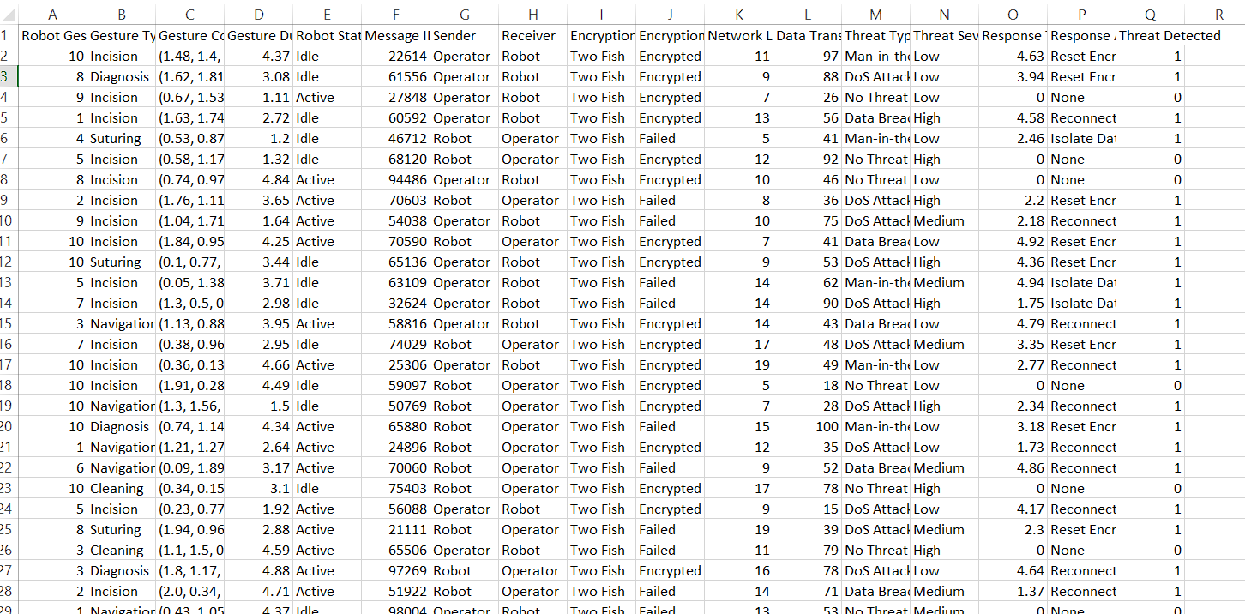
Dataset

Slide 10
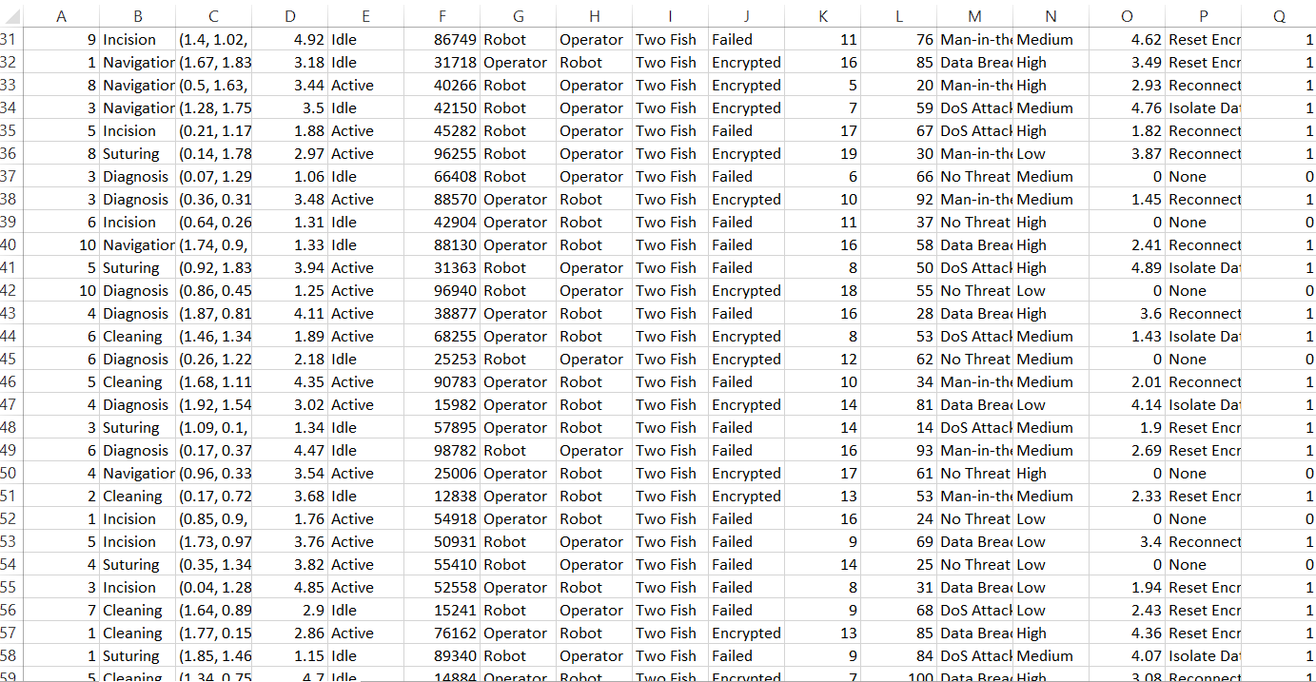
Dataset

Slide 11
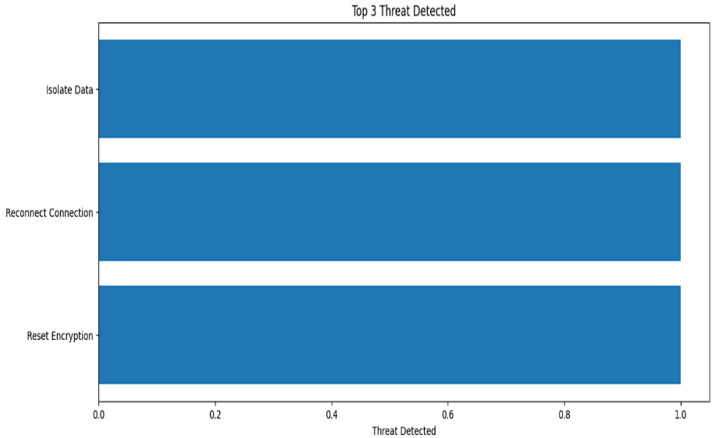
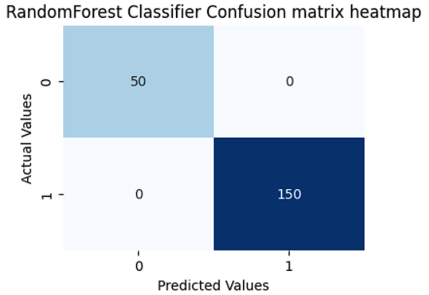
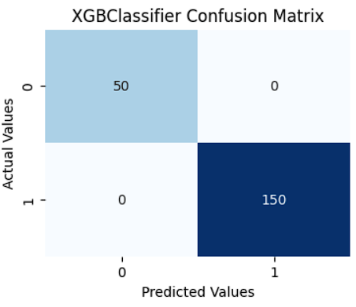
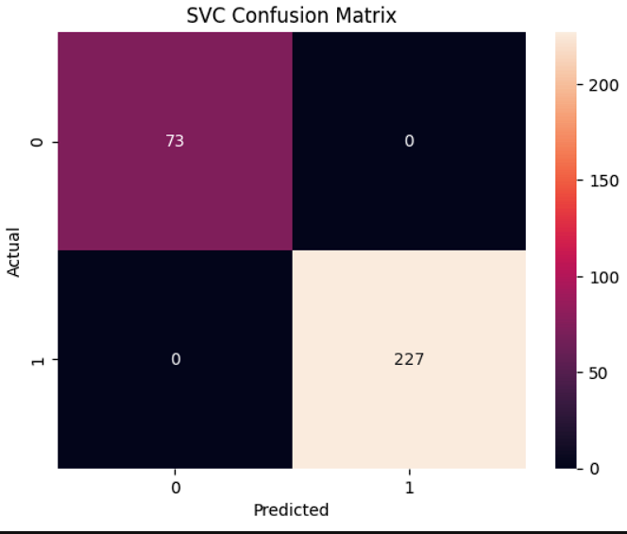
Graphical Overview

Slide 12
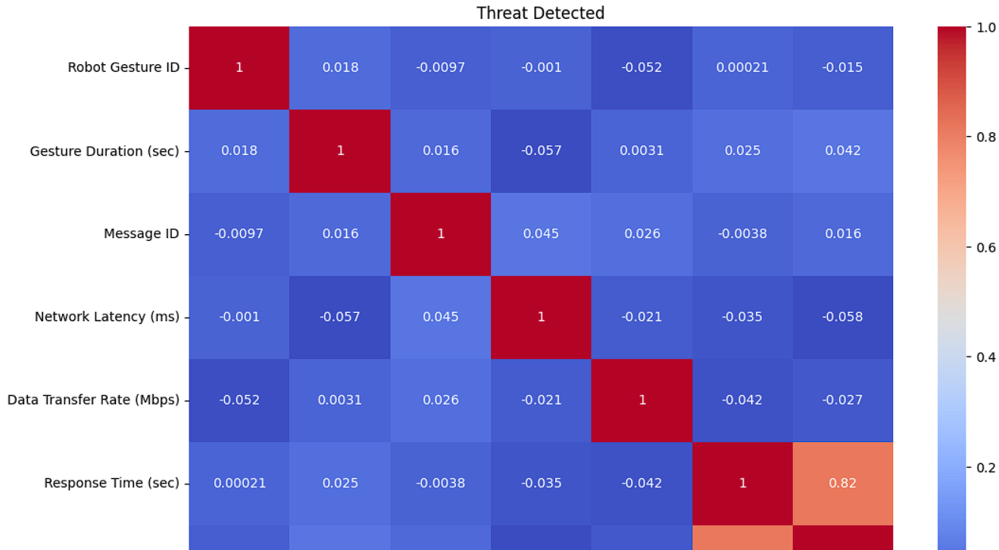
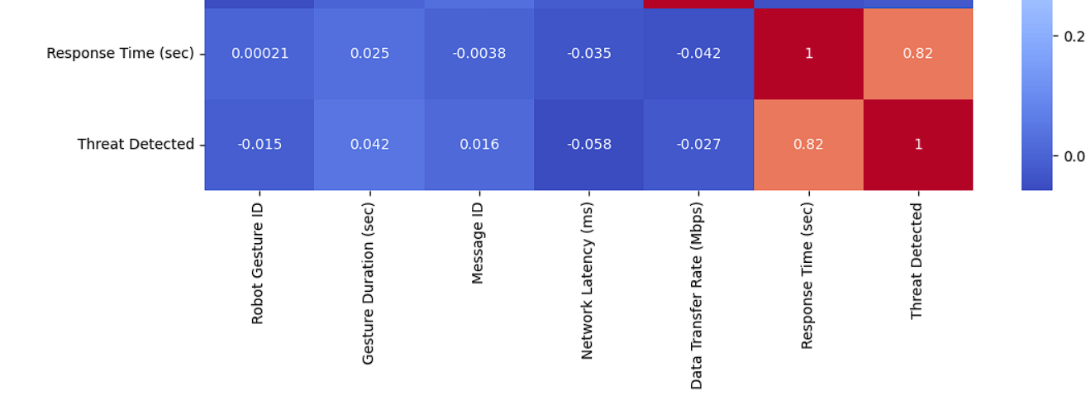
Graphical Overview

Slide 13
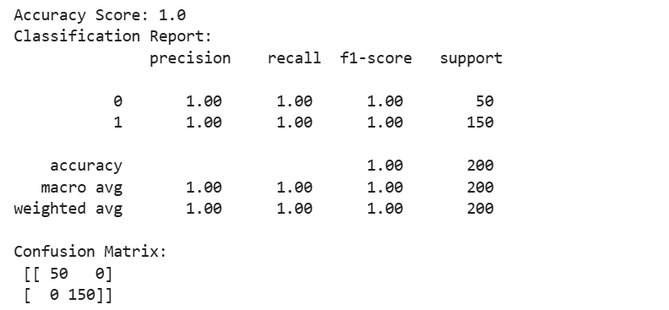
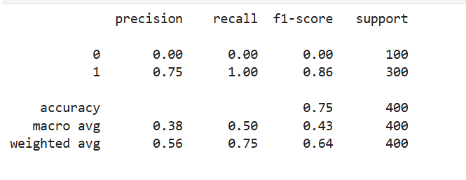
Result Obtained
RandomForest Classifier
XGB Classifier

Slide 14
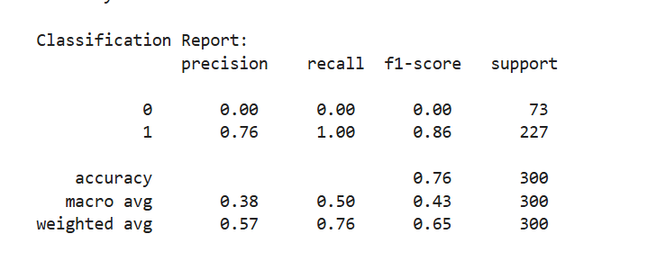
Result Obtained
SVC

Slide 15
Result Obtained
Model comparison Show how Random Forest and XGB performed differently, highlighting why one achieved perfect accuracy while the other struggled.
Evaluation awareness Explain why perfect scores can be misleading (data leakage, imbalance, overfitting) and why realistic evaluation matters.
Practical application Connect the models to real-world threat detection or anomaly detection tasks, showing business or security relevance.
Improvement strategies Present methods like cross-validation, SMOTE, or parameter tuning to improve weak models and reduce overfitting in strong ones

Slide 16
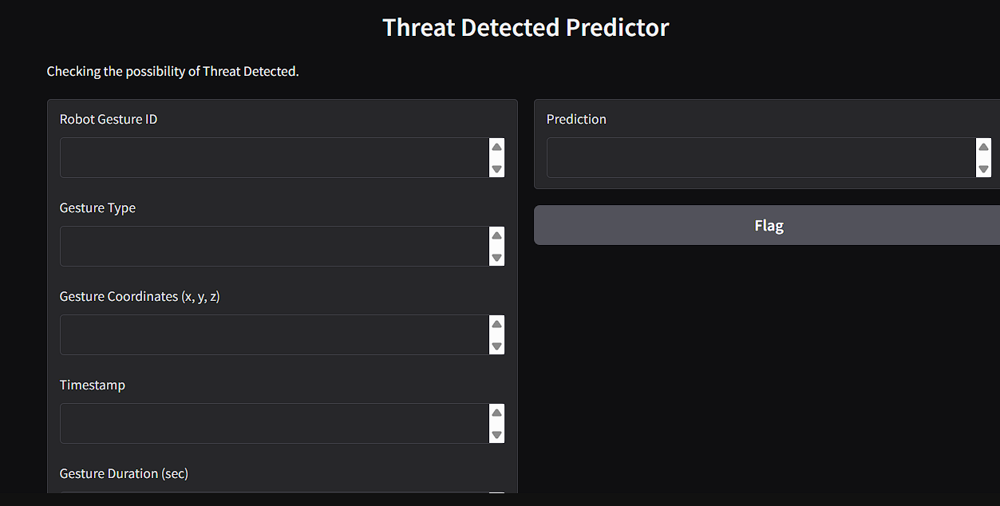
User Interface

Slide 17
Key Insights and Finding
High network latency directly impacts real-time robotic control, increasing the risk of surgical delays and command errors.
Authentication and access logs showed that unauthorized login attempts are one of the most frequent security vulnerabilities.
End-to-end encryption effectively protected live video streams and control signals from data interception

Slide 18
Conclusion
Cybersecurity plays a vital role in the success of telesurgery by ensuring safe, accurate, and reliable remote surgical operations. This study highlights how secure networks, real-time monitoring, and intelligent threat detection systems can reduce cyber risks and protect patient lives. By integrating advanced security techniques with machine learning models, telesurgery can become more trustworthy and efficient. Strengthening cybersecurity today will help build a safer future for remote healthcare and advanced medical technologies.

Slide 19
THANK YOU

